Slide 1
Diphtheria Outbreak Investigation & Response

Slide 2
Diphtheria Epidemiology
Reservoir: Human carriers, usually asymptomatic
Transmission: Respiratory, Skin and fomites rarely
Temporal pattern: Winter and spring
Communicability: Up to several weeks without antibiotics

Slide 3
Clinical Features: Diphtheria
Bacterial infection caused by Corynebacterium diphtheriae
Incubation period 2-5 days (range 1-10 days)
May involve any mucous membrane
Can cause infection of the nasopharynx, leading to breathing difficulties and death
The toxin can cause myocarditis
Other neuropathies occur and can mimic GBS
Non-cutaneous form of the disease with respiratory involvement has a case fatality rate of 5-10%
Cutaneous (skin infections) form is more common in tropical countries

Slide 4
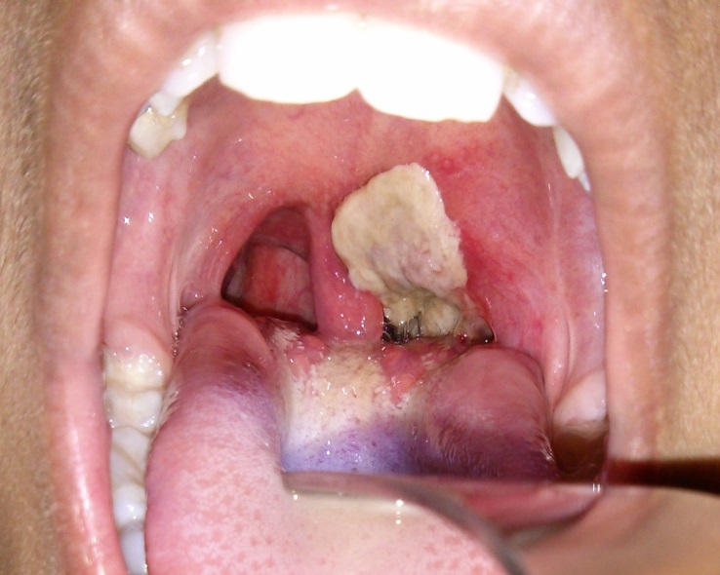
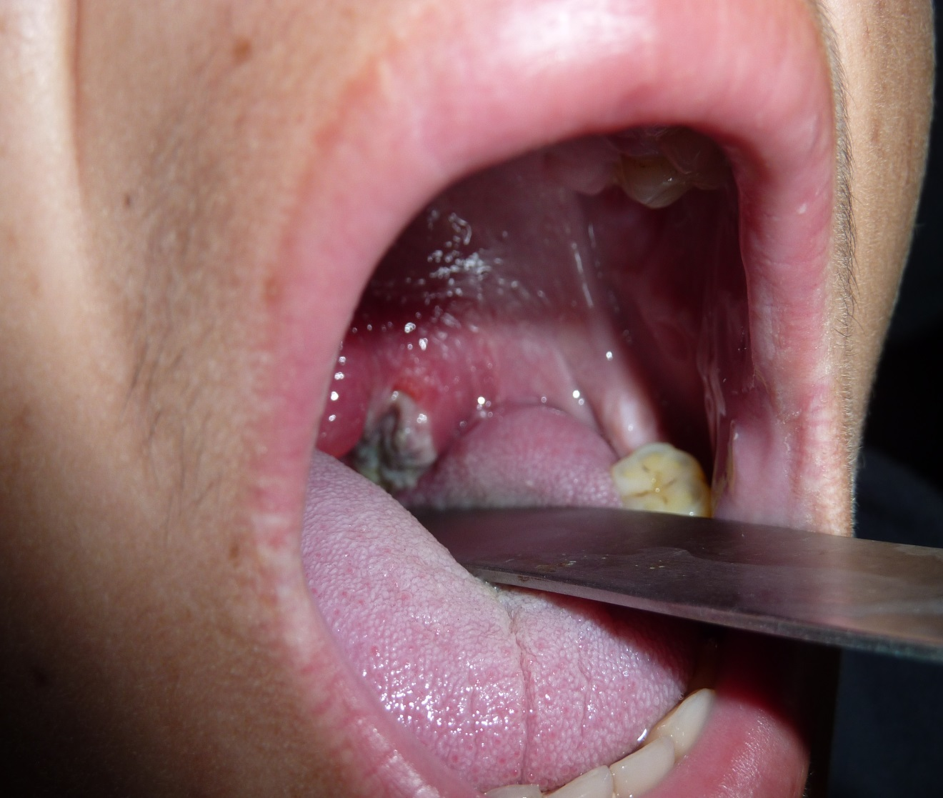

Slide 5
Case Definition
Case definition
Alert / outbreak criteria
Probable case:
An acute illness characterized by a visible adherent “membrane” on the tonsils, pharynx and/or nose and any one of these:
Laryngitis
Pharyngitis
Tonsillitis
Confirmed case:
A confirmed case is a probable case who has been laboratory confirmed or linked epidemiologically to a laboratory confirmed case.
Alert :
One probable case
Outbreak:
One confirmed case is an outbreak

Slide 6
OUTBREAK DETECTION AND INVESTIGATION

Slide 7
Who’s responsible for what?
Case investigation – attending MO
Weekly reporting or outbreak notification – HF I/C
Throat sample collection & transfer to district health office – HF I/C / EPI Technician
Sending specimen to NIH – EPI Coordinator/ DSO
Weekly report compilation & sending to the province – EPI Coordinator/DSO (DHO)
Notification of out break investigation team – DHO
Orientation & awareness building – DHO with active support of local partner agencies

Slide 8
Outbreak Investigation Team
EPI Coordinator/ DSO (Team Leader)
UCMO/ Health Facility I/C
DSV/ TSV
Local LHS
Local Vaccinator and LHWs
WHO DSO/ PEO

Slide 9
Action Points during Outbreak Investigation
Identification of geographical area with case reported through routine weekly reporting system
House-to-house search for other probable cases satisfying clinical case definition in past 1 month
Recording of all cases in outbreak line-list form and assign unique EPID number to each case
Collection of throat swab from other probable cases
Ensuring proper case management
Identify and enlist all unvaccinated or partially vaccinated children up to 5 year of age
Identify population at risk

Slide 10
House to House Case Search
Active community search for probable cases
If in village, whole village should be investigated
If in town, at least 30 households after last case should be investigated
Refer all probable Diphtheria cases to a Pediatrician or ENT specialist for specialist opinion

Slide 11
Case Response
Children age 45 days to 2 years
Unimmunized or partially immunized should receive 3 doses of Penta (at least 4 weeks apart) or complete the vaccination schedule
Children above 5 years and adults
3 doses of Td vaccine 1st dose on first contact, 2nd dose after 2 months and 3rd dose after 6-12 months.
Clinical diphtheria does not necessarily confer natural immunity, and patients should thus be vaccinated before discharge from a health facility with either primary or booster doses

Slide 12
Case Response….contd.
All close contacts regardless of vaccination history should have nose or throat culture
One dose of Benzathine Penicillin IM (600,000 Units for <6 years and 1.2 million units for 6 years and above) or a 7-10 days’ course of Erythromycin orally
If culture of contact is positive and person is symptomatic, admit the case in a hospital and treat as positive case
If culture is positive and the case is asymptomatic (carrier) treat with above antibiotics

Slide 13
Transportation of specimen
Throat/oral swab should be sent in reverse cold chain to National Bacteriology Laboratory, NIH Islamabad through DHO office.
Complete Part 1 of the Diphtheria CIF form after collection of specimen
Put specimens in zip locked plastic bags
Place ice packs along the sides of the specimen carrier
Place the specimen in the center and place the foam pad at the top
Place the CIF in a separate plastic bag
Inform the concerned laboratory personnel about the dispatch of sample over telephone
Note: Leopard courier services are already paid by WHO for transportation of laboratory specimens

Slide 14
Follow-up of outbreak investigation
In outbreak investigation, follow-up of cases should be performed 30 days after the initial investigation. The objective is to find:
Outcome of cases
Complications
Whether the outbreak is still continuing in the same area
Fill in the last columns of outbreak line list

Slide 15
Dosage & Treatment with DAT
WHO recommend the following schedule for (DAT)
For mild cases with laryngeal or pharyngeal disease, 20,000 - 40,000 IU
For moderate nasopharyngeal disease, 40,000 - 60,000 IU
For severe extensive or late cases 60,000 - 80,000 IU
Removal of membrane to prevent airway obstruction.
DAT has no role once complications start

Slide 16
Thanks

